Slide 1
Linear Equations in Linear Algebra
The Matrix Equation Ax=b
Bumhee Cho

Slide 2




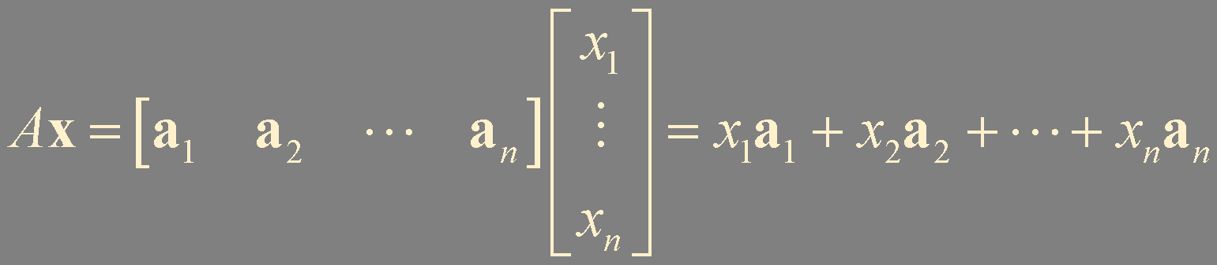
: product of
and
ℝ^{m}
the linear combination of the columns of
using the corresponding entries in as weights

Slide 3
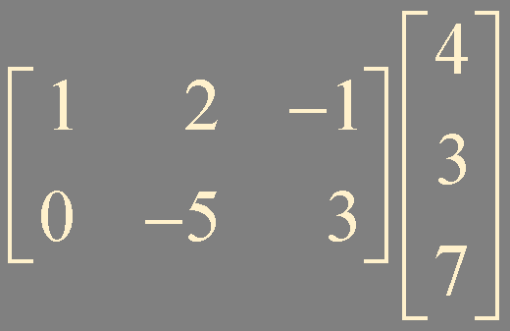
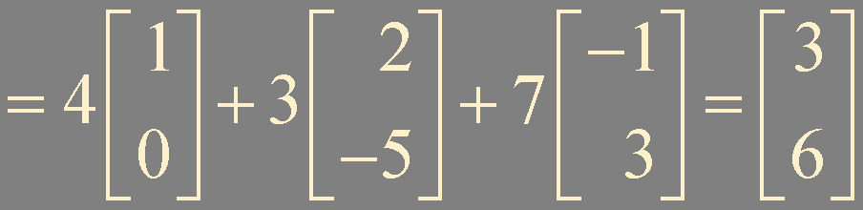
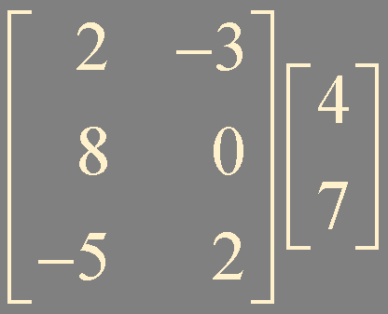
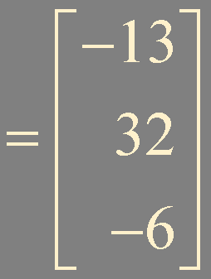
Example 1. Matrix equation

Slide 4
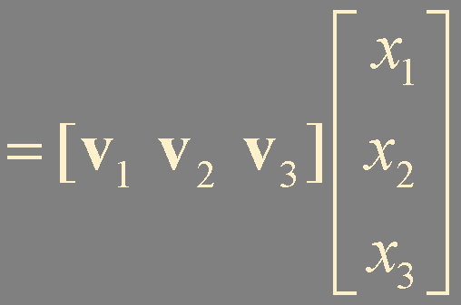

Example 2. Vector equation to matrix equation

Slide 5
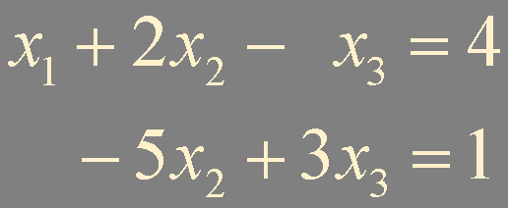
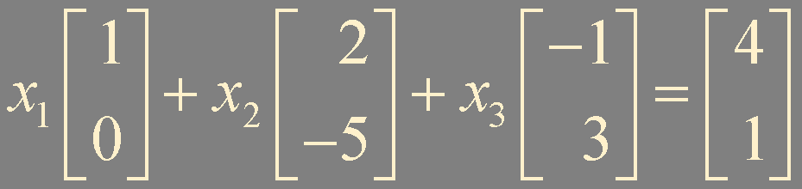
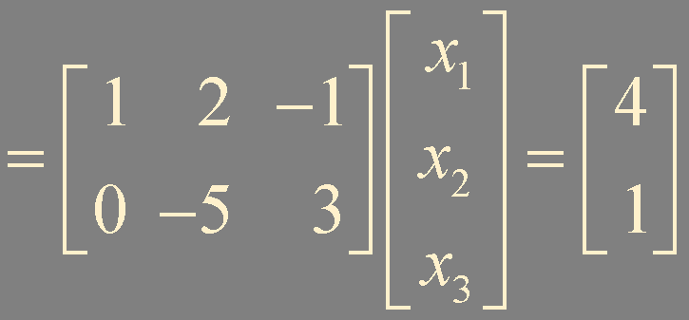
Example 3. system of linear equations to matrix equation

Slide 6
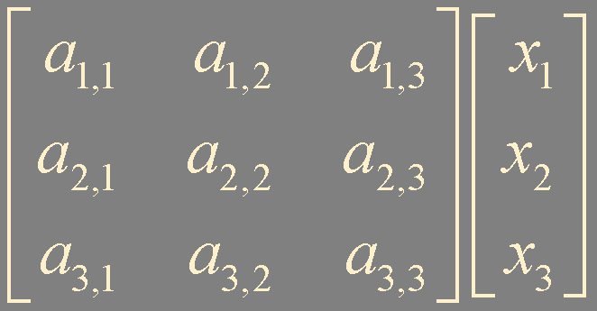
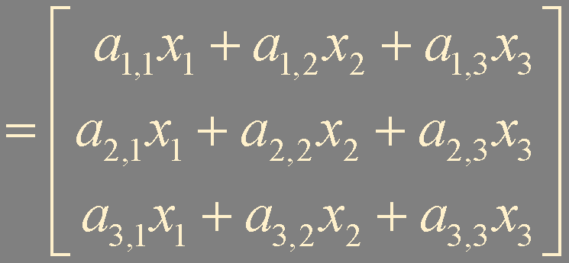

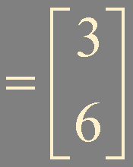



Example 4. more efficient way to compute matrix equation
identity matrix

Slide 7




Theorem 3.
matrix equation:
vector equation:
augmented matrix:
have the same solution set !

Slide 8
Theorem 2. Existence and Uniqueness Theorem
A linear system is consistent if and only if the rightmost column of the augmented matrix is not a pivot column - that is, if and only if an echelon form of the augmented matrix has no row of the forms
If a linear system is consistent, then the solution set contains either (i) a unique solution, when there are no free variables, or (ii) infinitely many solutions, when there is at least one free variables.

Slide 9


Theorem 4.
The followings are all true or all false;
Not augmented matrix
Notes:
augmented matrix 에 0000b 행이 최소한 요 부분에 nonzero 항이 있어야한다는 뜻이고 이건 d와 동일한 말

Slide 10
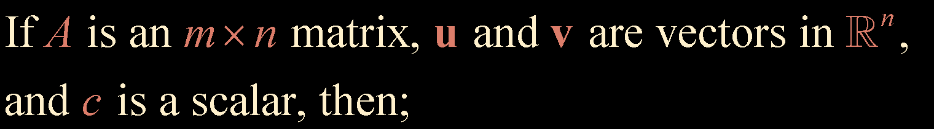


Theorem 5.

Slide 11
Summary
matrix equation
Theorems 3-5

